Slide 1
We introduce you to your Personal Assistant -
J. A. V. A.
(Just Another Voice Assistant)

Slide 2
Introduction
With the rise of artificial intelligence and machine learning, personal assistants have become smarter and more intuitive than ever before. Whether it's Siri on your iPhone, Alexa on your Amazon Echo, or Google Assistant on your Android device, these virtual assistants are now an integral part of our daily lives. They can help us with a variety of tasks such as setting reminders, making phone calls, playing music, and even ordering groceries.

Slide 3
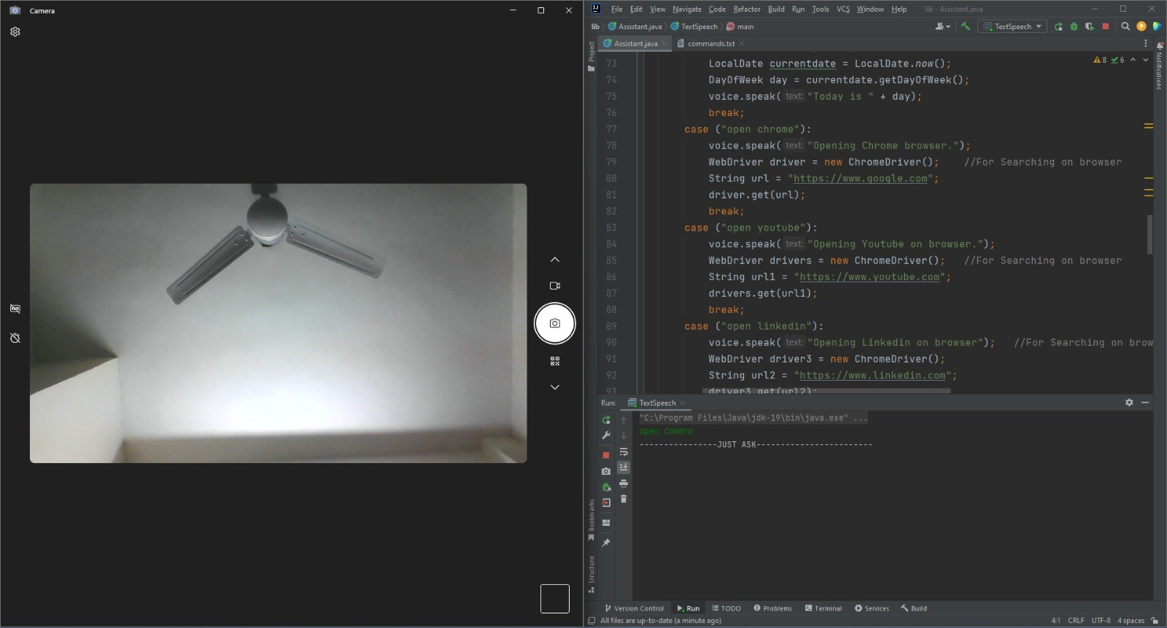
J. A. V. A.
This is a Personal Assistant for you which works just like other assistants which can do simple tasks like telling the time, opening the web browser, and
Accessing Inbuilt Apps

Slide 4
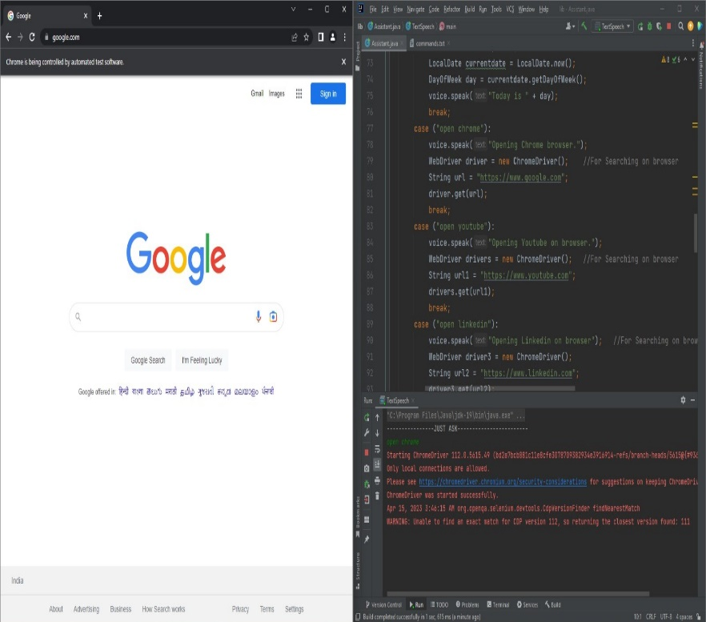
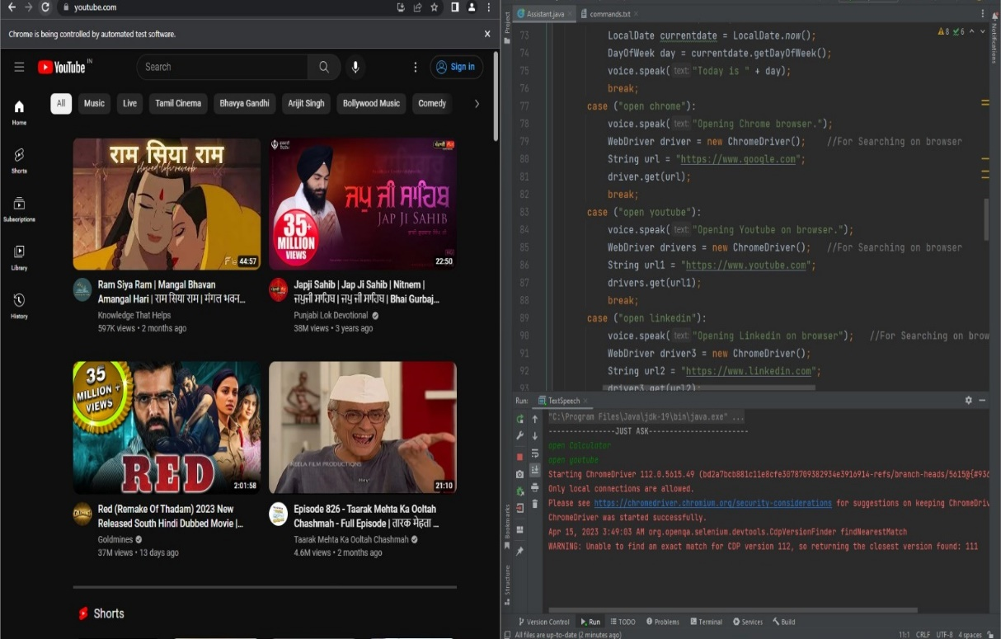
Some more functions
Accessing Google
Accessing Youtube

Slide 5
Libraries included for making this Project
Freetts -> For Voice
Openqa -> For Browser Searches
Awt -> For Opening Windows Application
Time -> For Getting Time, Day of Week, Today’s Date

Slide 6
Future of J.A.V.A.
Development on GUI for JAVA.
Speech input to be taken by assistant.
Platform independency of assistant.
New features will be added like contact listing,
calling, etc.

Slide 7
Thank You!
From Team:
Saquib Nadeem – 12105826
Aditya Sharma – 12111592
Amit Kumar Dansena – 12111643
Abhishek Kumar - 12106473

